Slide 1

Protocol: NIDA-CTN-0027
Starting Treatment with
Agonist Replacement Therapies (START)
Drs. Walter Ling and Andrew Saxon, Lead Investigators
APHA Meeting, Nov. 1, 2011

Slide 2
Presenter Disclosures
Andrew J. Saxon, M.D.
(1) The following personal financial relationships with commercial interests relevant to this presentation existed during the past 12 months:
No Relationships to Disclose

Slide 3
Study Objectives
The Food and Drug Administration (FDA) requested a study comparing buprenorphine/naloxone (BUP/NX) and methadone (MET) on indices of hepatic safety.
PRIMARY
Compare changes in liver enzymes related to treatment with BUP/NX to changes in liver enzymes related to treatment with MET.
SECONDARY
Identify risk factors at baseline and during treatment that could contribute to interactions with BUP/NX or MET causing liver dysfunction. Assess abstinence from illicit substances. Assess abstinence from alcohol.

Slide 4
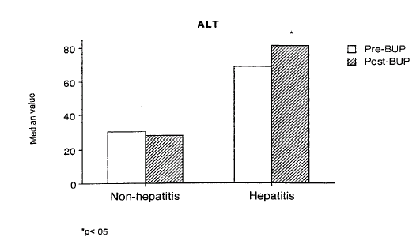
Elevated Liver Enzyme Levels in
Patients with Hepatitis Treated with Buprenorphine
+Hepatitis n=72
-Hepatitis n=48
Tx’ed w/ Bup ≥40 days
Petry et al., 2000

Slide 5
Buprenorphine and
Liver function
Case reports:
  Eleven case reports of hepatitis:
    Transaminase increases, 9-68x normal, with IV (n=5) or SL (n=6) buprenorphine in patients infected with Hepatitis C

Slide 6
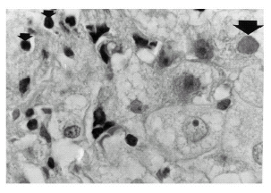
Liver Bx from HIV pos, HCV pos Patient on Buprenorphine with Acute Hepatitis
Acidophilic Body
Infiltrating Mononuclear Cells
Microvesicular Steatosis
Berson et al., 2001

Slide 7
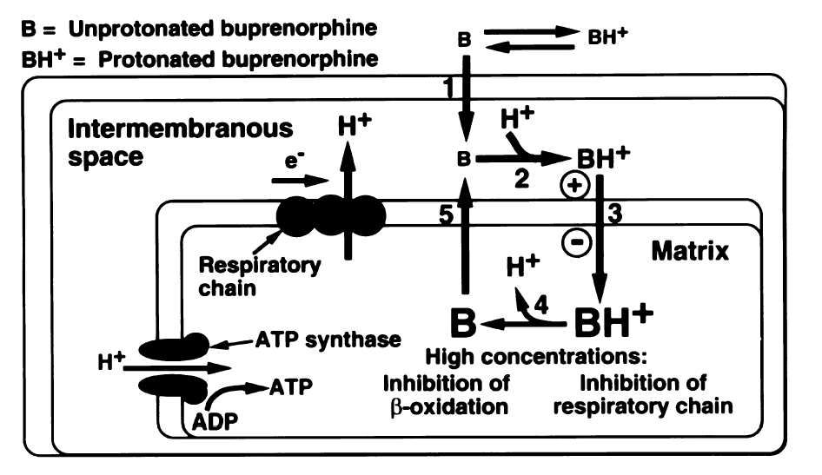
Experimental Buprenorphine Hepatotoxicity:
Mitochondrial Dysfunction
Berson et al., 2001

Slide 8
START Study Schema
 | 1920 Number screened for participation
 | 1269 Randomized
740 Buprenorphine/Naloxone |  |  |  |  | 529 Methadone
340 Evaluable 400 Failed to remain on assigned medication for 24 wks 0 Failed to provide ≥ 4 LT samples |  |  |  |  | 391 Evaluable 136 Failed to remain on assigned medication for 24 wks 2 Failed to provide ≥ 4 LT samples
261 Completed 32-week follow-up |  |  |  |  | 330 Completed 32-week follow-up

Slide 9
Outcome Measures/Analysis
Primary Outcome
  Changes in liver enzymes (transaminases)
Primary analysis
  Descriptive
  Shift Tables
    ≤2X ULN remain ≤2X ULN
    ≤2X ULN then ↑ >2X ULN
    >2X ULN then ↓ ≤2X ULN and remain ≤2X ULN
    >2X ULN do not ↓ ≤2X ULN or ↑ >2X eligibility value
    >2X then ↑ >2X eligibility value

Slide 10
Outcome Measures/Analysis
Secondary Outcomes
Effects of:
  (a.) Use of dirty needles
  (b.) Alcohol use
  (c.) Presence or absence of HIV
  (d.) Heavy cigarette smoking
  (e.) Hepatitis B or C +
  (f.) Illicit drug use
  On changes in liver enzymes by medication group
  modeled through survival analysis and trajectory analysis

Slide 11
Participant Characteristics
 | BUP/NX (n=740) | MET (n=529)
Females | 238 (32.2%) | 170 (32.1%)
Age | 37.5 (11.2) | 37.3 (10.9)
Injected in past 30 days | 508 (68.6%) | 368 (69.6%)

Slide 12
Participant Characteristics
 | BUP/NX (n=740) | MET (n=529)
Hispanic Ethnicity | 125 (16.9%) | 81 (15.3%)
White | 514 (69.5%) | 392 (74.1%)
African American | 63 (8.5%) | 47 (8.9%)
Other Race | 163 (22%) | 90 (17%)

Slide 13
Baseline Substance Use
% Reported Days Use Past 4 Weeks | BUP/NX (n=740) M (SD) Median | MET (n=529) M (SD) Median
Opioids | 81.3 (32.1) 100 | 82.5 (31.6) 100
Cocaine | 10.7 (23.5) 0 | 11.6 (23.3) 0
Alcohol | 4.6 (14.8) 0 | 5.8 (17.2) 0
Benzodiazepines | 2.1 (8.5) 0 | 1.8 (8.6) 0
Cannabis | 10.4 (26.5) 0 | 8.4 (22.8) 0

Slide 14
Baseline Substance Use
% Positive Urine Drug Screen | BUP/NX (n=740) | MET (n=529)
Opiates | 644 (87.0%) | 459 (86.8%)
Oxycodone | 103 (13.9%) | 78 (14.7%)
Cocaine | 252 (34.1%) | 222 (42.0%)
Benzodiazepines | 141 (19.1%) | 95(18.0%)
Cannabis | 187 (25.3%) | 113 (21.4%)

Slide 15
Baseline Liver Health
 | BUP/NX (n=740) | MET (n=529)
Abnormal Transaminase Levels | 84 (11.4%) | 58 (11.0%)
Hep BSAb | 213 (28.8%) | 177 (33.5%)
Hep BSAg | 3 (0.4%) | 3 (0.6%)
HCV Ab | 268 (36.2%) | 221(41.8%)
HCV RNA | 208 (28.1%) | 147 (27.8%)

Slide 16
Fagerstrom Test for
Nicotine Dependence
Baseline FTND Score | Mean | SD | Median
BUP/NX Smokers=88.2% | 4.4 | 2.2 | 4.0
MET Smokers=90.9% | 4.3 | 2.2 | 4.0
No substantial changes in number of smokers or FTND at week 12 or 24

Slide 17
Dosing
Highest Dose in mg | Mean | SD | Median
BUP/NX (buprenorphine) | 22.3 | 9.2 | 24
MET | 93.2 | 43.9 | 90
% dispensed ranged from 95.1% week 1 to 83.4% week 24
175.3 total dose years for BUP/NX
197.1 total dose years for MET

Slide 18
Main Liver Outcomes
AST and ALT | BUP/NX (n=340) | MET (n=391)
≤2X ULN remain ≤2X ULN | 273 (80.3%) | 306 (78.3%)
≤2X ULN then ↑ >2X ULN | 43 (12.6%) | 70 (17.9%)
>2X ULN then ↓ ≤2X ULN and remain ≤2X ULN | 11 (2.4%) | 5 (1.3%)
>2X ULN do not ↓ ≤2X ULN or ↑ >2X eligibility value | 1 (0.2%) | 2 (0.5%)
>2X then ↑ >2X eligibility value | 9 (2.6%) | 6 (1.5%)

Slide 19
Liver Outcomes
Adjusted For Dose Years
AST and ALT | BUP/NX (n=340) | MET (n=391)
≤2X ULN remain ≤2X ULN | 1.57 | 1.56
≤2X ULN then ↑ >2X ULN | 0.25 | 0.36
>2X ULN then ↓ ≤2X ULN and remain ≤2X ULN | 0.06 | 0.03
>2X ULN do not ↓ ≤2X ULN or ↑ >2X eligibility value | 0.01 | 0.01
>2X then ↑ >2X eligibility value | 0.01 | 0.01

Slide 20
Log Rank Test: ≤2X ULN to ≥2X ULN

Slide 21
Predictors: ≤2X ULN to ≥2X ULN
Cox regression controlling for:
Medication Condition
Alcohol use
Cigarette use
Drug use
Sharing needles
Hepatitis B or C at Baseline
(HR=2.40; 95%CI 1.46, 3.92)
Not significant

Slide 22
Extreme Elevations in Liver Functions
24 participants had extreme elevations
  9 BUP/NX
  15 MET
  ALTs ranging from 418 to 6280 (n=15)
  ASTs ranging from 493 to 6940 (n=8)
  INRs ranging from 3.62 to 5.60 (n=7)
  Direct Bilirubin ranging from 0.7 to 3.7 (n=6)
  Total Bilirubin 2.8, 5.0 (n=2 )

Slide 23
Extreme Elevations in Liver Functions
24 participants with extreme elevations compared to 821 participants w/o extreme elevations.
No significant effect of:
  Age
  Gender
  Race
  Ethnicity
  Use of unsafe injection equipment
  Hepatitis at baseline
  Alcohol use during trial (self-reported)

Slide 24
Extreme Elevations in Liver Functions
24 participants with extreme elevations compared to 821 participants w/o extreme elevations.
 | Extreme El. | No Extreme El. | p
Hep B/C Seroconversion | 2/15 (13.3%) | 7/419 (1.7%) | .035
Median % Drug use week 4 | 38.9 | 22.2 | .033
Median % Drug use week 8 | 29.6 | 11.1 | .034
Median % Drug use week 12 | 21.4 | 13.0 | ns
Median % Drug use week 16 | 18.2 | 9.9 | ns
Median % Drug use week 20 | 18.8 | 10.0 | ns
Median % Drug use week 24 | 26.9 | 13.8 | ns

Slide 25
Treatment Retention

Slide 26
Opiate Positive UDS (%)
GEE Analysis Bup*time χ²=92.41, p<.0001

Slide 27
Cocaine Positive UDS (%)
GEE Analysis Bup*time χ²=40.55, p<.04

Slide 28
Patients’ Reasons for Non-completion
Suboxone
Common to Both
Groups
Methadone
Negative experiences with medication (e.g., induction)
Opiate use
Program procedures/
policies
Switched to methadone maintenance
Incarceration
Wanted methadone
Transportation
Wanted to feel full agonist effects
Life events
Inconvenience
Didn’t feel needed medication still
Didn’t want
medication long-term

Slide 29
Wanted to Feel
Full Agonist Effect
“I was hopin’ for the methadone. If I’d gotten that, I’d have stayed the whole eight months. There’s no doubt in my mind…But being that it worked so well as a blocker, it didn’t work out for me, so I stopped.” male patient
“When I would take methadone, it would kinda give me energy, I guess I would say, where the Suboxone didn’t do that for me. Just that little bit of, not really euphoric. I don’t’ know how to explain the feeling – just made me feel good.” female patient
29

Slide 30
START
Ancillary Pharmacogenetics Study
Optional enrollment for main study participant
Blood collected at week 2 for study of pharmacodynamic genes (n=804)
(Wade Berrittini)
Blood and urine collected at week 12 for study of pharmacokinetic genes (n=645) (Lindsay DeVane)

Slide 31
Objectives for PK Genetics
Identify Important Determinants of Intersubject Variability in Drug Disposition and Response
  Demographic: Age, Body Weight, gender, race
  Genetic: enzyme and transporter polymorphisms; targets of opioid system
  Environmental: Smoking, Diet
  Physiological/Pathophysiological: Renal (Creatinine Clearance) or Hepatic impairment, Disease State
  Concomitant Drugs
  Other Factors: Meals, Circadian Variation, Formulations

Slide 32
Potentially Relevant Polymorphisms
Enzymes and Transporters Involved in Drug Disposition
CYP2D6
CYP2C19
CYP3A4
ABCB1 (P-glycoprotein)
BCRP (Breast Cancer Resistance Protein)
Target Molecules Associated with Opioid Addiction
POMC
PDYN
PENK
OPRM1
OPRD1
DRD2

Slide 33
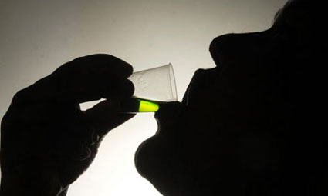
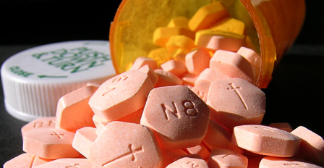
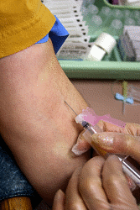
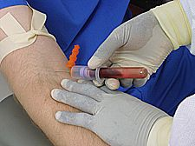
In Context
1,920 opioid-dependent individuals screened across 9 CTPs, 6 nodes.
1,269 randomized to receive
Suboxone or methadone
Over 23,775 participant visits conducted
and over 143,000 daily doses dispensed.
10 scheduled blood draws per participant,
plus additional draws as needed
Over 9,600 blood draws collected!
Notes:
Trend has been fairly stable over time.

Slide 34
Summary
No differences detected in the liver effects of buprenorphine vs. methadone
No clear evidence of any serious liver injury from either medication
Hepatitis and ongoing illicit drug use look like the main drivers of worsening indices of liver health in opioid dependent population

Slide 35
Summary
Buprenorphine treatment can be successfully integrated into the licensed OTP setting
Treatment retention worse with buprenorphine vs. methadone
In open label trial with adequate dose levels buprenorphine was superior to methadone in reducing illicit opiate and cocaine use

Slide 36
It takes a CTNetwork to conduct a
successful trial!
Evergreen Treatment Services, and the Pacific Northwest Node
CODA Inc. and the Oregon Hawaii Node
Bi-Valley Medical Clinic, and the California/Arizona Node
Connecticut Counseling Centers
Hartford Dispensary, and the New England Node
NET Steps, and the Delaware Valley Node
Bay Area Addiction Research & Treatment
Matrix Institute, and the Pacific Region Node
Addiction Research & Treatment Corp, and the New York Node
Medical University of South Carolina - Genetics
University of Pennsylvania – Genetics
Rutgers Cell and DNA Repository
UCLA - Retention
Duke Clinical Research Institute (DSC)
EMMES Corporation (CCC)
& our CCTN liaisons‘ and NIDA Sponsor!
Notes:
NIDA, NIH, DHHS

