Slide 1
ADAPTIVE RESEARCH DESIGN FOR SUBSTANCE ABUSE CLINICAL TRIALS
Presented by:
Katharina Wiest, PhD
Jennifer Sharpe Potter, PhD, MPH
October 23, 2013

Slide 2
Objectives
Distinguish between adaptive trial design and adaptive treatment/intervention design.
Review adaptive treatment/intervention design in the CTN.
Caveat: Analytic approaches are outside the scope of this presentation.
FOR FURTHER INFORMATION:
LIVELINK: Adaptive treatment strategies
Workshop presentations
SMART design
Supplementary material

Slide 3
What is meant by "Adaptive" in research descriptions
Different ways “adaptive” used in clinical research within evolving fields. Different ways to adapt:
Adaptive treatment/intervention
The intervention or delivery of the intervention in a trial.
Adaptive design
A current ongoing trial.
Future trials.
Common Feature - data collected informs trial decisions

Slide 4
Adaptive Trial Design
Adaptive Research Design

Slide 5
Definition of Adaptive Trial Design
"…. a clinical study design that uses accumulating data to modify aspects of the study as it continues, without undermining the validity and integrity of the trial.…changes are made by design, and not on an ad hoc basis…not a remedy for inadequate planning."
Gallo, et al, 2006
This trial design - primarily from research in the pharmaceutical industry; more limited public health applications.

Slide 6
Comparison between Conventional & Adaptive Clinical Trial Designs
Features | Conventional trial | Adaptive design
Design | More rigid | Flexible
Treatment arms | Maximum two or three | Many simultaneously
Hypothesis | Test the hypothesis under consideration | Fit data into a hypothesis
Modifications | Not allowed without protocol amendments | Pre-specified modifications allowed
Phases | Phases I–III distinct, well-defined | Can be seamless phase II/III designs
Statistical analysis | Use routine methods | Uses more complex Bayesian approach
Organization | Much simpler | Complicated, requiring simulations
Interim analysis | Not routine (except safety) | Done routinely & frequently
Role of IDMC* | More once trial/phase is over | Proactive role throughout the trial
Regulatory view | Well-endorsed | Still speculative
*IDMC: Independent data-monitoring committee
Mahajan, 2010

Slide 7
Types of Adaptive Clinical Trial Designs (not adaptive treatment/interventions!) Brown et al., 2009, Adaptive design for randomized trials in public health, Annual Review of Public Health
What is Adaptive | Based on | Example | Benefit | Special Trial Requirement | Caution
Early Stopping | Interim analysis of impact | Group sequential trial | Reduced time / cost to completing trial | Requires short time for outcomes to be measured | Wider confidence intervals at planned trial end
Optimal Dose | Re-allocation of dosages based on estimated dose-response relationship | Dose finding trial | Efficient determination of dosages | Requires short time for outcomes to be measured | Confounding of dose by entry time
Sample Size | Interim analyses | Re-estimation of variance components | Appropriate sample size | Requires short time for outcomes to be measured | Inflated Type 1 error
Enrollment Procedure | Limited enrollment in traditional randomized design | Randomize before consent | Increased proportion enrolled; decreased selection bias | None | Ethical concerns; especially with single consent design
Run-in Prior to Randomization | Prediction of drop-out | Run-in design to lower drop-out | Improved statistical power | Multiple responses for baseline | Selection bias; effects of training
Encouragement | Predictors of adherence | Motivational interviewing | Reduction in participation bias | None | Modeling sensitive to assumptions
Allocation Probabilities | Co-variates of prior subjects | Co-variate adaptive allocation | Enhanced balance in intervention assignment | none | May introduce confounding with time
Follow-up | Response on proximal targets | Two-stage follow-up design | Efficient design for follow-up | Longitudinal follow-up | None

Slide 8
Adaptive treatment/intervention
Adaptive Research Design

Slide 9
Adaptive Treatment / Intervention Rationale
Target Population?
Individuals with a chronic relapsing illness or disease.
Why?
Heterogeneity of patients & environment
Dosage &/or treatment varies between patients & within an individual over time.
Goal: provide the minimum treatment which provides the optimal response.
How is this different from clinical judgment?

Slide 10
Adaptive Treatment / Intervention Rationale
Continued
Best Example within NIDA:
SMART (Sequential Multiple Assignment Randomized Trial).
Susan Murphy, PhD.
http://methodology.psu.edu/ra/adap-inter/projects

Slide 11
Definition of Adaptive Treatment / Intervention
A sequence of individually tailored decision rules that specify whether, how, and/or when to alter the intensity, type, dosage, or delivery of treatment at critical decision points in the course of care.
http://www-personal.umich.edu/~dalmiral/slides/IMPACT_NC_2nov2012.pdf

Slide 12
Adaptive Treatment / Interventions
Evaluate sequences of treatment decisions for individual patients or participants.
Decisions incorporate time-varying information on:
Treatment responses
Side effects
Patient preferences
Participants may be randomized multiple times at decision points based on rules of how & when treatments change.

Slide 13
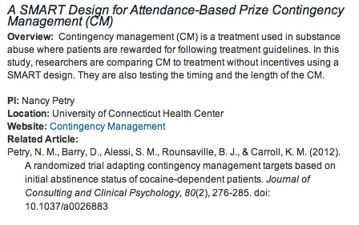
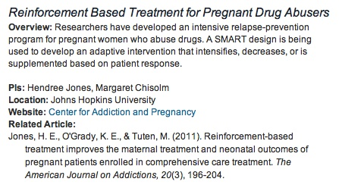
Examples from SUD treatment

Slide 14
Example: Traditional Randomized Medication / Intervention Trial Design

Slide 15
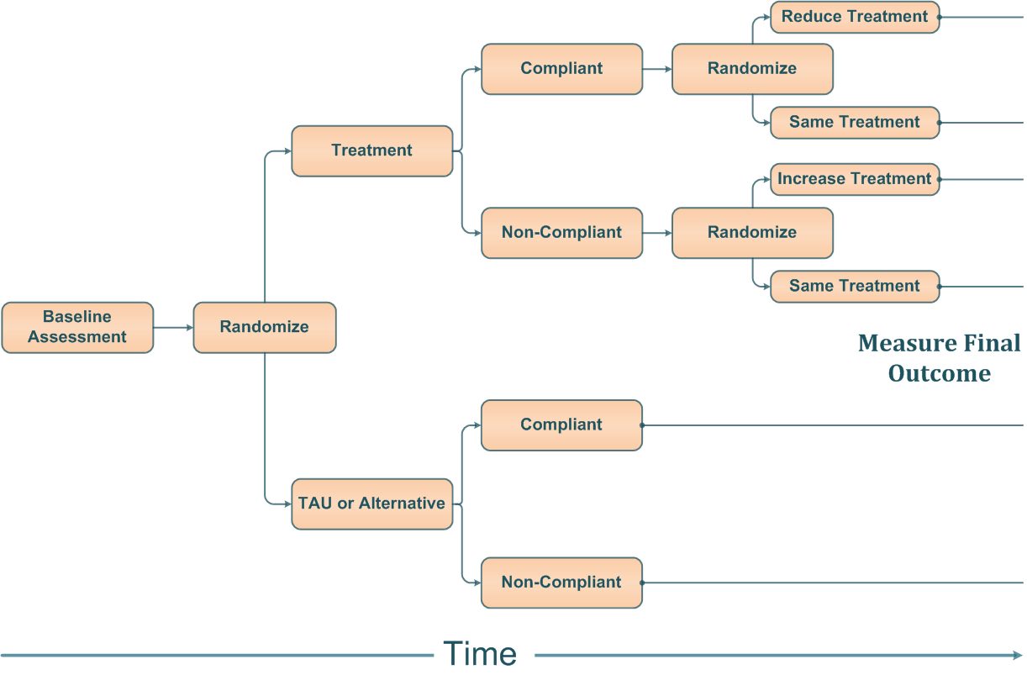
Example: Adaptive Randomized Treatment / Intervention Trial Design

Slide 16
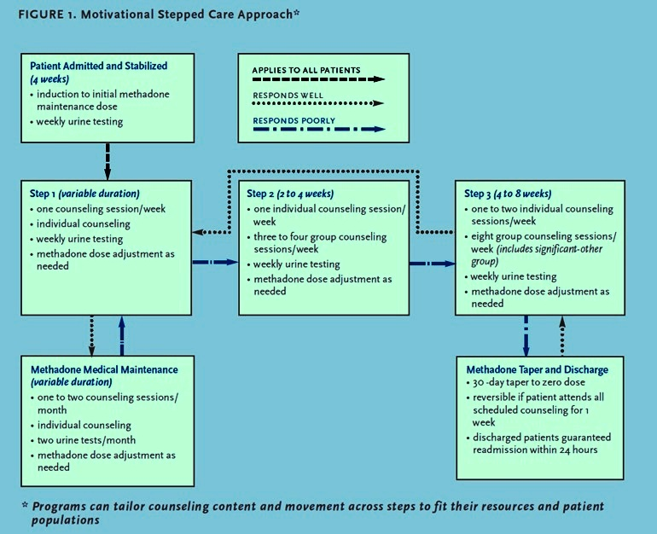
Another Example of Adaptive Treatment/Intervention
Brooner, RK, Kidorf, M (2002) Using Behavioral Reinforcement To Improve Methadone Treatment Participation Sci Pract Perspect. 1(1): 38–47.

Slide 17
Example within the CTN
Adaptive Research Design (adaptive intervention)

Slide 18
CTN-0030 POATS Study
Does adding individual drug counseling to buprenorphine-naloxone (BUP-NX) + standard medical management (SMM) improve outcome:
During initial detox
Over a longer stabilization period?
18
Notes:
The primary research question for the study was: What benefit does SMM+ODC offer over SMM in (a) a short-term treatment paradigm (a four-week buprenorphine-naloxone treatment with taper) and (b) a longer-term treatment paradigm (12 weeks of a stabilization dose of buprenorphine-naloxone) for subjects who have not responded successfully to the initial short-term buprenorphine-naloxone treatment with taper?

Slide 19
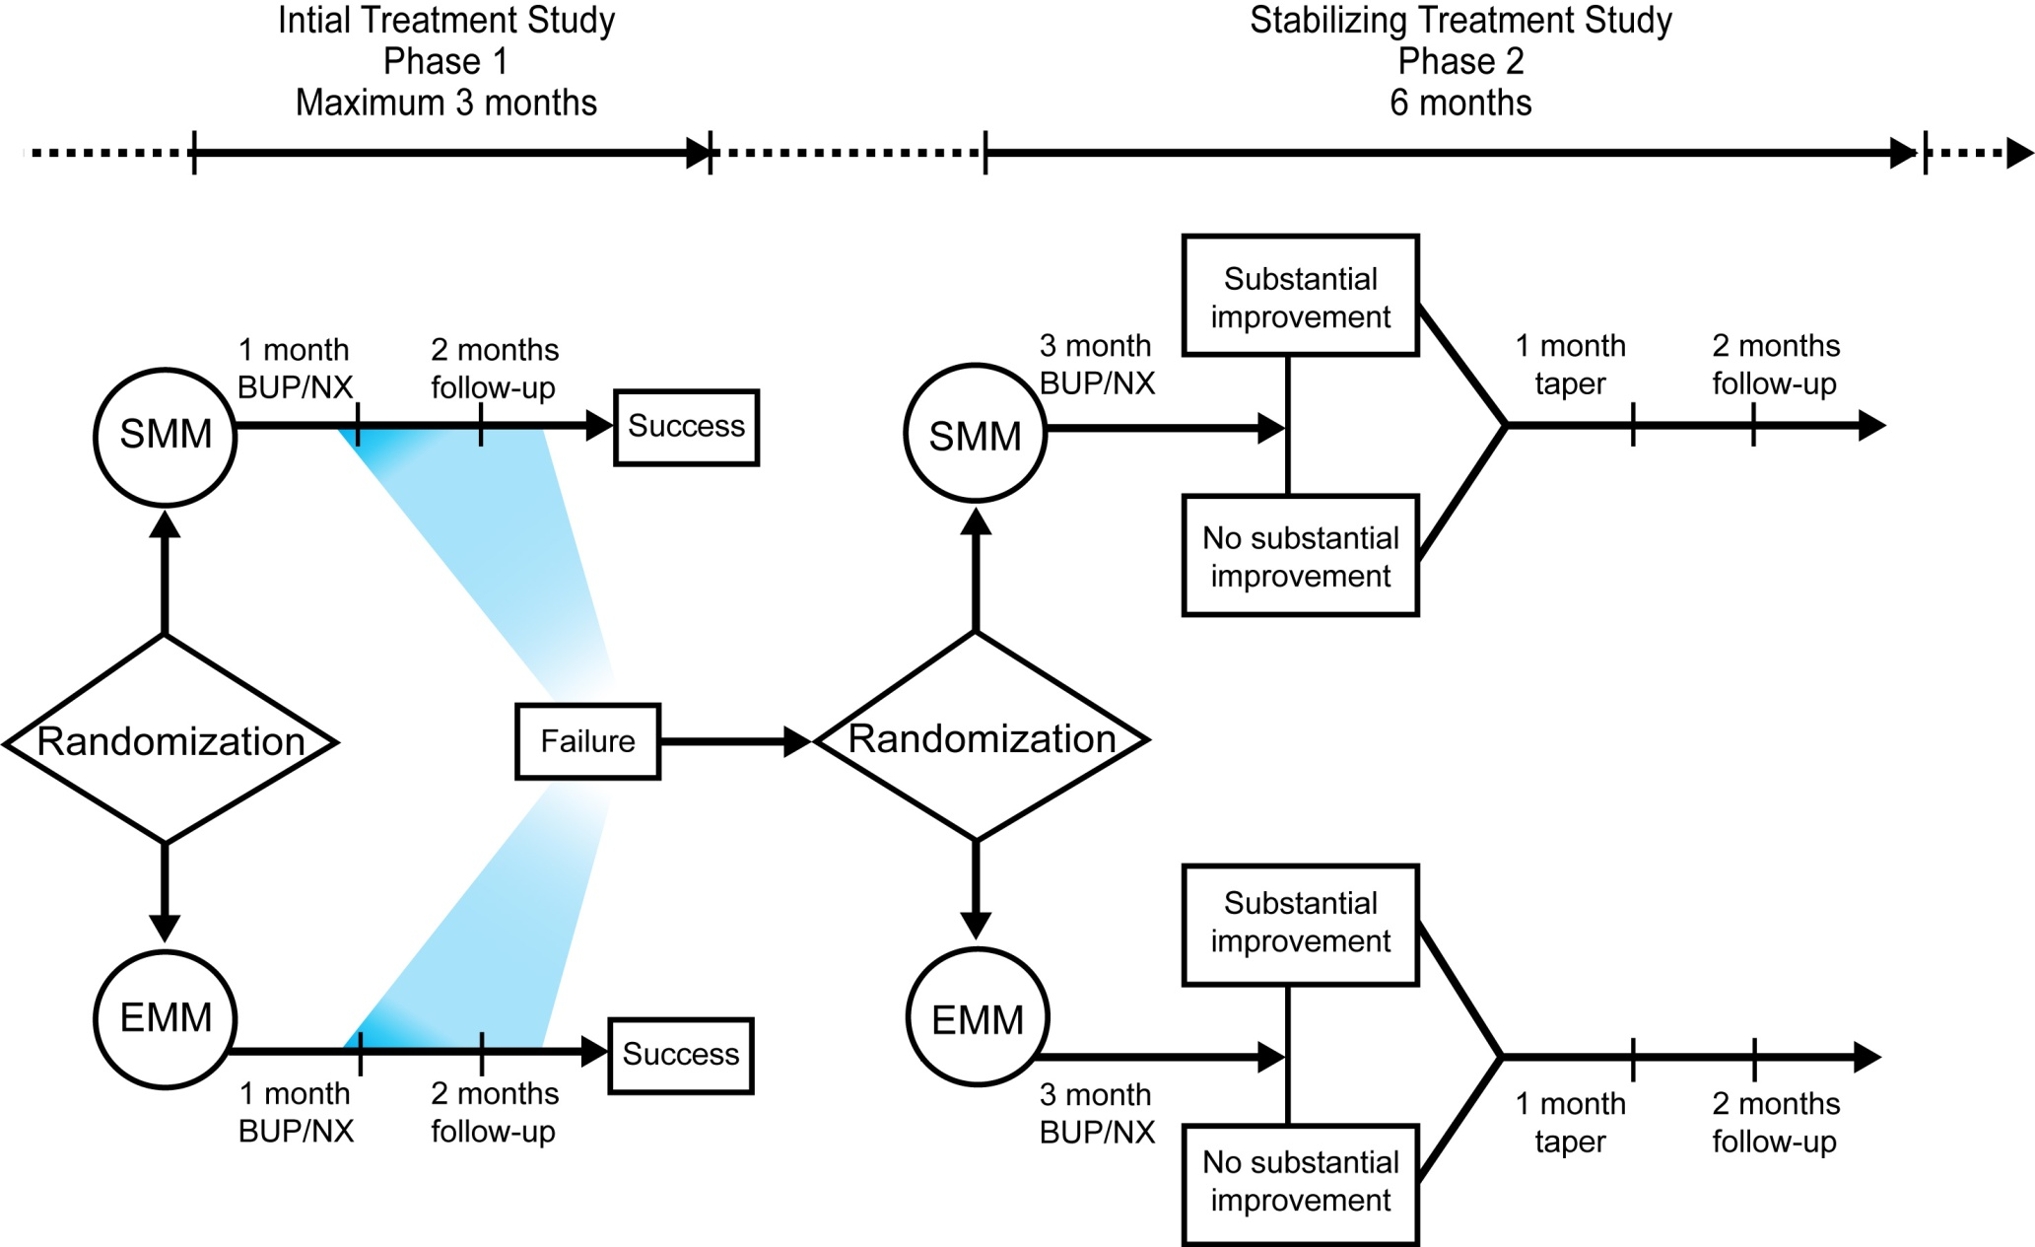
POATS: Study Schema
19
Notes:
The primary research question for the study was: What benefit does SMM+ODC offer over SMM in (a) a short-term treatment paradigm (a four-week buprenorphine-naloxone treatment with taper) and (b) a longer-term treatment paradigm (12 weeks of a stabilization dose of buprenorphine-naloxone) for subjects who have not responded successfully to the initial short-term buprenorphine-naloxone treatment with taper?

Slide 20
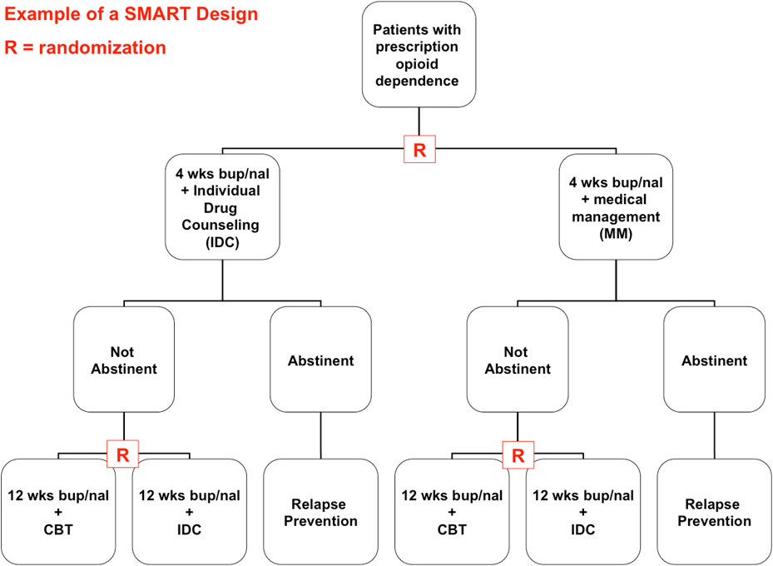
Example SMART Design
Scott, Levy, & Murphy 2007
20
Notes:
The primary research question for the study was: What benefit does SMM+ODC offer over SMM in (a) a short-term treatment paradigm (a four-week buprenorphine-naloxone treatment with taper) and (b) a longer-term treatment paradigm (12 weeks of a stabilization dose of buprenorphine-naloxone) for subjects who have not responded successfully to the initial short-term buprenorphine-naloxone treatment with taper?

Slide 21
The same SMART Design can be used to answer many different kinds of research questions:
About components of an adaptive treatment strategy:
What is the effect of initial treatment assignment on long term outcome given specified treatments provided in the interim?
Considering only patients who did not respond to the initial treatment, what is the best subsequent psychosocial treatment in the context of a 12 week buprenorphine/naloxone detoxification: IDC vs. CBT?

Slide 22
The same SMART Design can be used to answer many different kinds of research questions:
Continued
About entire strategies:
What is the difference in long term outcomes between two strategies that begin with a different treatment?
Which of the four possible strategies is the best strategy (i.e., results in highest average long term outcome)?
Scott, Levy, & Murphy 2007

Slide 23
Recap and highlights

Slide 24
Adaptive Treatment/Interventions & Adaptive Clinical / Experimental Designs
These ideas are not (necessarily) related & may lead to terminology confusion.
Adaptive treatment/interventions are a type of intervention design
Adaptive experimental designs are particular type of experimental design
SMARTs are not Adaptive Experimental Designs
SMARTs do inform development of Adaptive Interventions
http://www-personal.umich.edu/~dalmiral/slides/IMPACT_NC_2nov2012.pd

Slide 25
Recap of Adaptive Treatment / Interventions & Adaptive Clinical Trials
Both require more pre-planning
Design
Statistical
Approval process
Both provide important benefits
Nimble
Identify more optimal treatments &/or doses
Within CTN
More likely to use Adaptive Treatment/Interventions than Adaptive Designs

Slide 26
Q&A – Questions / Comments
Alternatively, questions can be directed to the presenter by sending an email to CTNtraining@emmes.com.

Slide 27
References
Bierman, KL, Nix, RL, Maples, JL, et al (2006) Examining clinical judgment in an adaptive intervention design: the fast track program. J Consult Clin Psychol. 74(3):468-481.
Brooner, RK, Kidorf, M (2002) Using Behavioral Reinforcement To Improve Methadone Treatment Participation Sci Pract Perspect.1(1): 38–47.
Brown, CH, Ten Have, TR, Jo, B et al. (2009)Adaptive designs for randomized trials in public health. Annu Rev Public Health. 30:1-25.
Coffey, CS, Levin, B, Clark, C, et al. (2012) Overview, hurdles, and future work in adaptive designs: perspectives from a National Institutes of Health-funded workshop. Clinical Trials. 9:671-680.
Gallo, P, Chuang-Stein, C, Dragalin, V, et al (2006) Adaptive designs in clinical drug development – an executive summary of the PhRMA working group. J of Biopharmaceutical Statistics. 16:275-283.
Kairalla, J., Correy, C., Thoman, M. and Muller, K. (2012). Adaptive trial designs: A review of barriers and opportunities. Trials 13(145). PMCID: PMC3519822. Retrieved from http://www.trialsjournal.com/content/13/1/145.

Slide 28
References
Continued
King, VL, Kidorf, MS, Stoller, KB et al (2006) A 12 month controlled trial of methadone medical maintenance integrated into an adaptive treatment model. J Subst Abuse Treat. 31:385-393.
Mahajan, R, Gupta, K (2010) Adaptive design clinical trials: Methodology, challenges and prospect. Indian J Pharmacol. 42(4):201-207.
Marlowe, DB, Festinger, DS, Arabia, PL, et al. (2008) Adaptive interventions in drug court: a pilot experiment. Crim Justice Rev. 33(3):343-360.
Murphy, SA (2005) An experimental design for the development of adaptive treatment strategies. Statistics in Medicine. 24:1455-1481.
US Department of Health and Human Services Food and Drug Administration, Center for Drug Evaluation and Research (CDER) Center for Biologics Evaluation and Research CBER. (2010). Guidance for industry: Adaptive design in clinical trials for drugs and biologics (Draft). Retrieved from http://www.fda.gov/downloads/Drugs/.../Guidances/ucm201790.pdf.

Slide 29
Survey Reminder
The NIDA CCC encourages all to complete the survey issued to participants directly following this webinar session, as this is the primary collective tool for rating your experience with this and other webinars, and for communicating the interests and needs of CTN members and associates.
Upcoming Webinar
GETTING MULTI-SITE TRIALS UP AND RUNNING ON TIME
Wednesday, November 20, 2013
1:00 pm to 2:30 pm ET

Slide 30
A copy of this presentation will be available electronically after this session.
http://ctndisseminationlibrary.org

Slide 31
Thank you for participating.
NIDA CTN Web Seminar Series

